Slide 1
Azure Cognitive Services in SPFx
Kirti Prajapati
SharePoint Consultant
@kirtipprajapati

Slide 2


Sponsors

Slide 3

Kirti Prajapati
SharePoint Consultant
Office Development MVP
MCTS
O365, SharePoint & Office Dev Specialist
Speaker | Blogger | Author | Trainer
Organizer of Ahmedabad SharePoint User Group
aOS Ambassador
Contact Details
Email : kirti.Prajapati@gmail.com
Twitter : @kirtipprajapati
FB : facebook.com/kirti.Prajapati.7374
LinkedIn : linkedin.com/in/kirtiprajapati

Slide 4
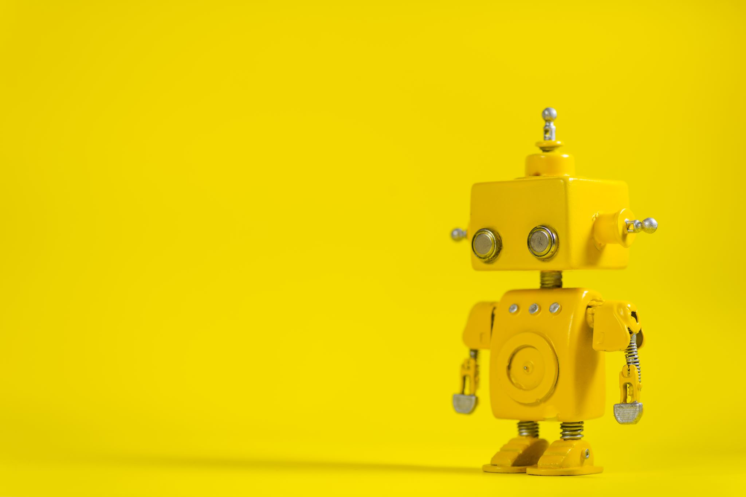
What is Artificial Intelligence

Slide 5
AI is the capability of a machine to imitate intelligent human behavior.
Source: Microsoft

Slide 6




























AI is already all around us!

Slide 7
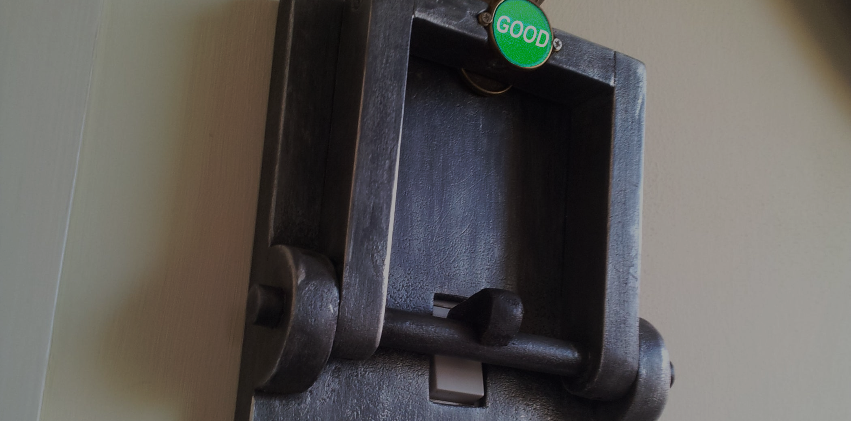
Artificial Intelligence uses in SharePoint Framework (SPFx)
For good, not evil!

Slide 8
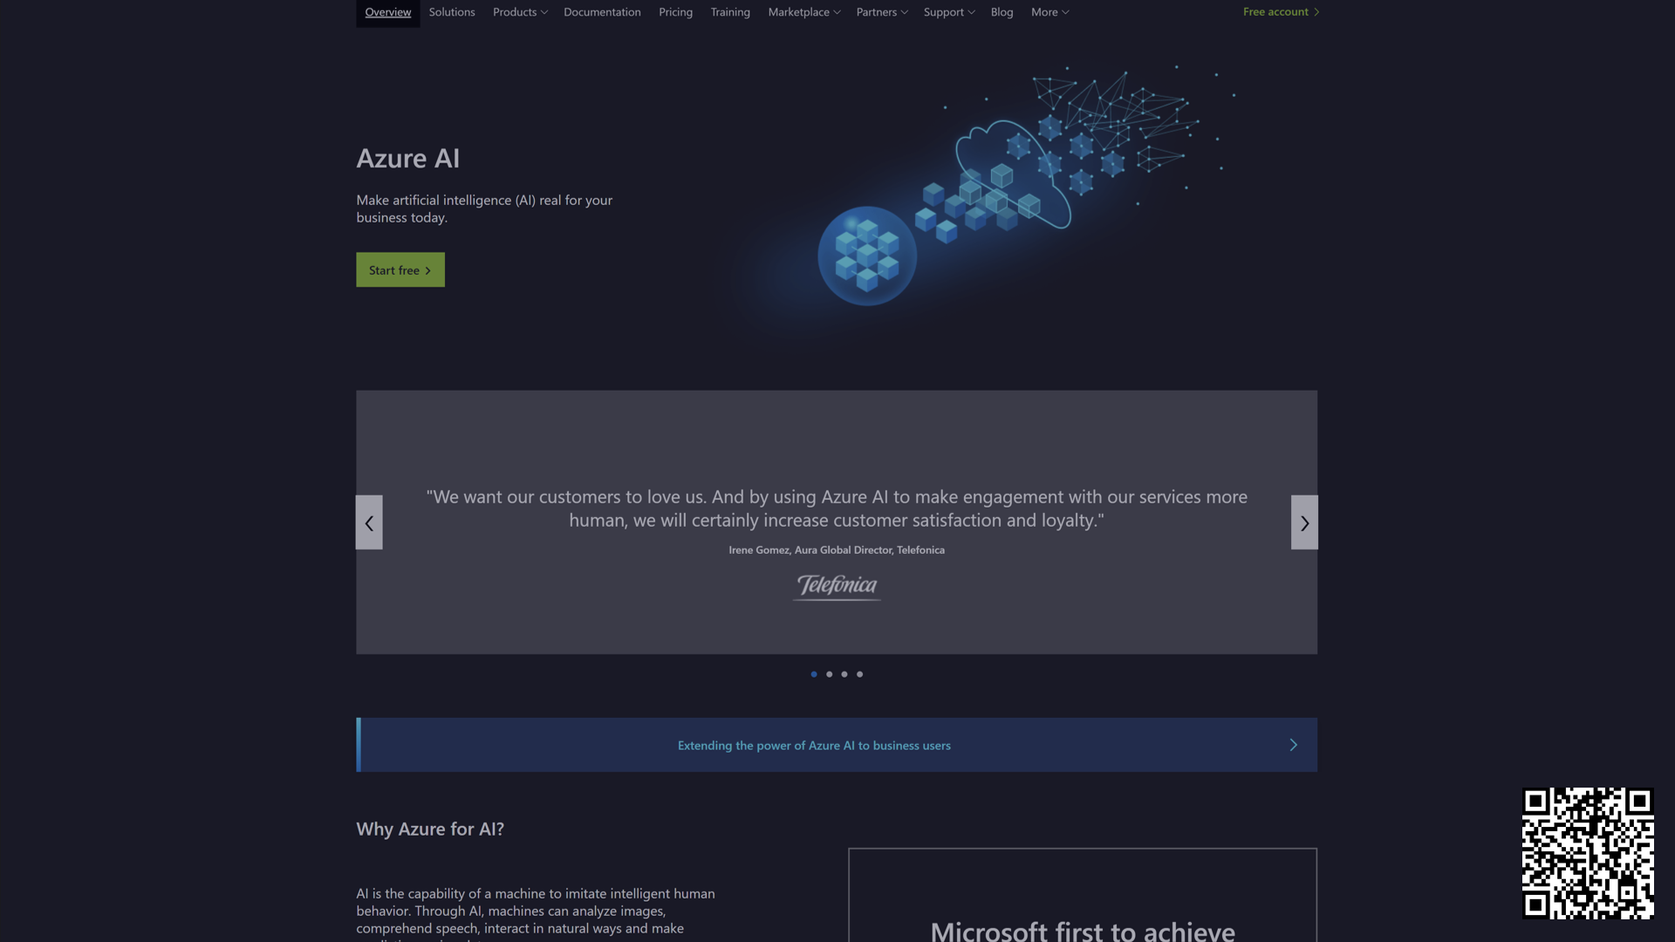

Slide 10








Slide 11
Vision
Decision
Speech
Search
Language

Slide 12



Vision
Computer Vision
Facial Recognition
Ink
Recognition

Slide 13
Vision
Decision
Speech
Search
Language

Slide 14


Speech
Speech to text Text to speech Speech translation
Speaker Recognition

Slide 15
Vision
Decision
Speech
Search
Language

Slide 16

Language
Text analytics

Slide 17
Vision
Decision
Speech
Search
Language

Slide 18





Search
Spell
Check
Bing Search
Bing Autosuggest
Bing Custom Search
Bing Entity Search

Slide 19
Vision
Decision
Speech
Search
Language

Slide 20


Decision
Anomaly Detection
Personalizer

Slide 21
Vision
Decision
Speech
Search
Language

Slide 22
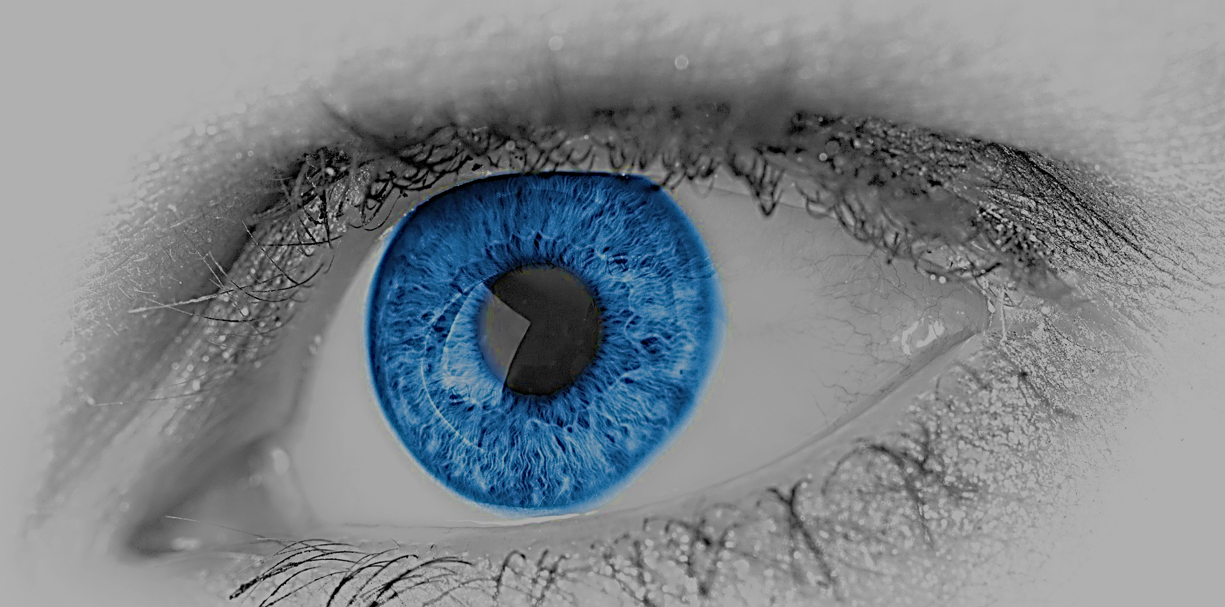
Vision

Slide 23
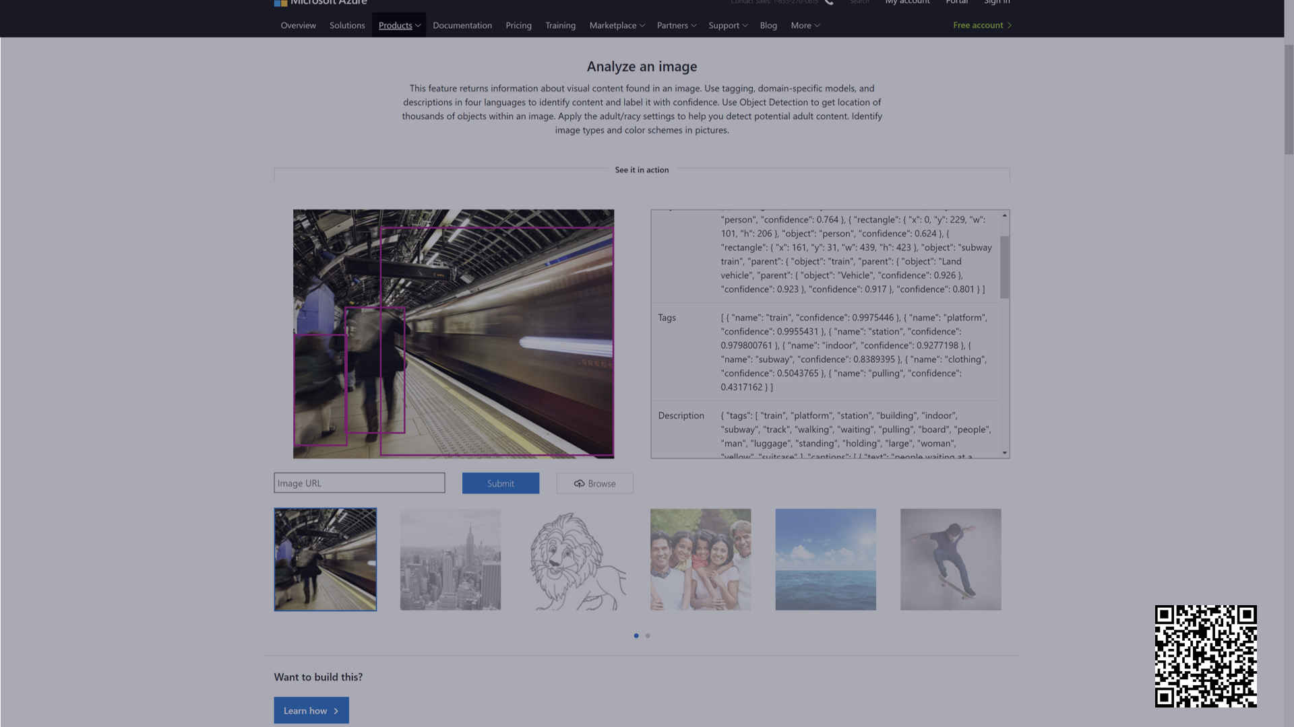

Slide 24
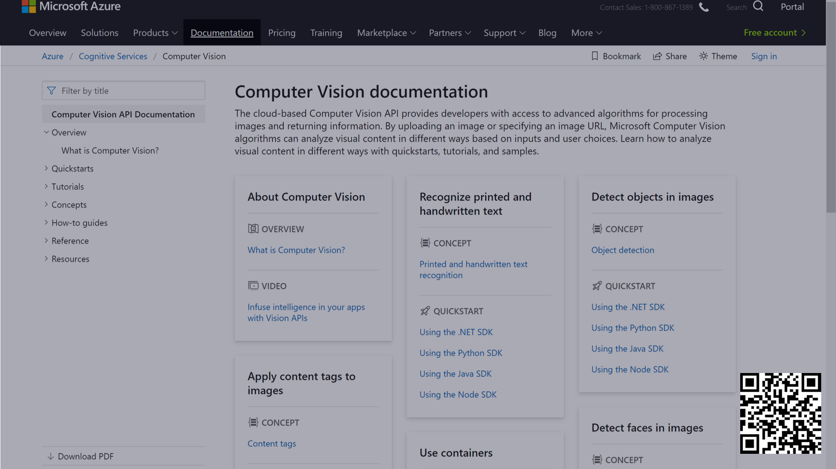

Slide 25
Demo

Slide 26
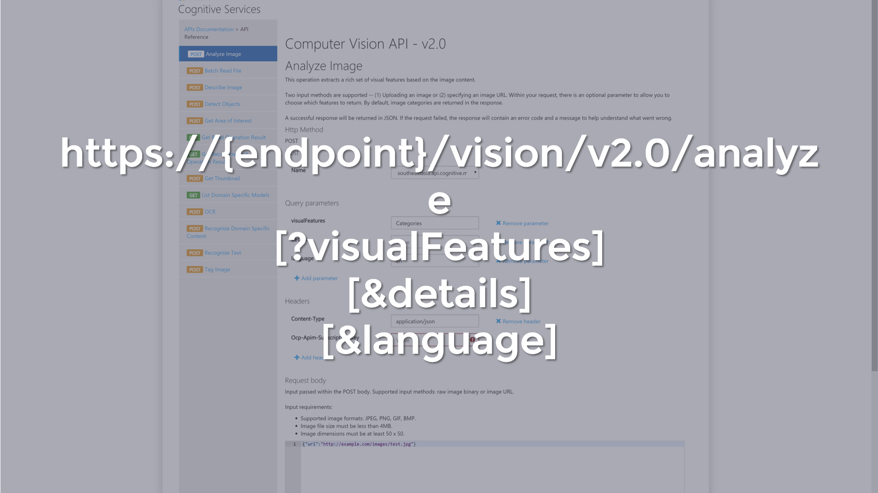

Slide 27
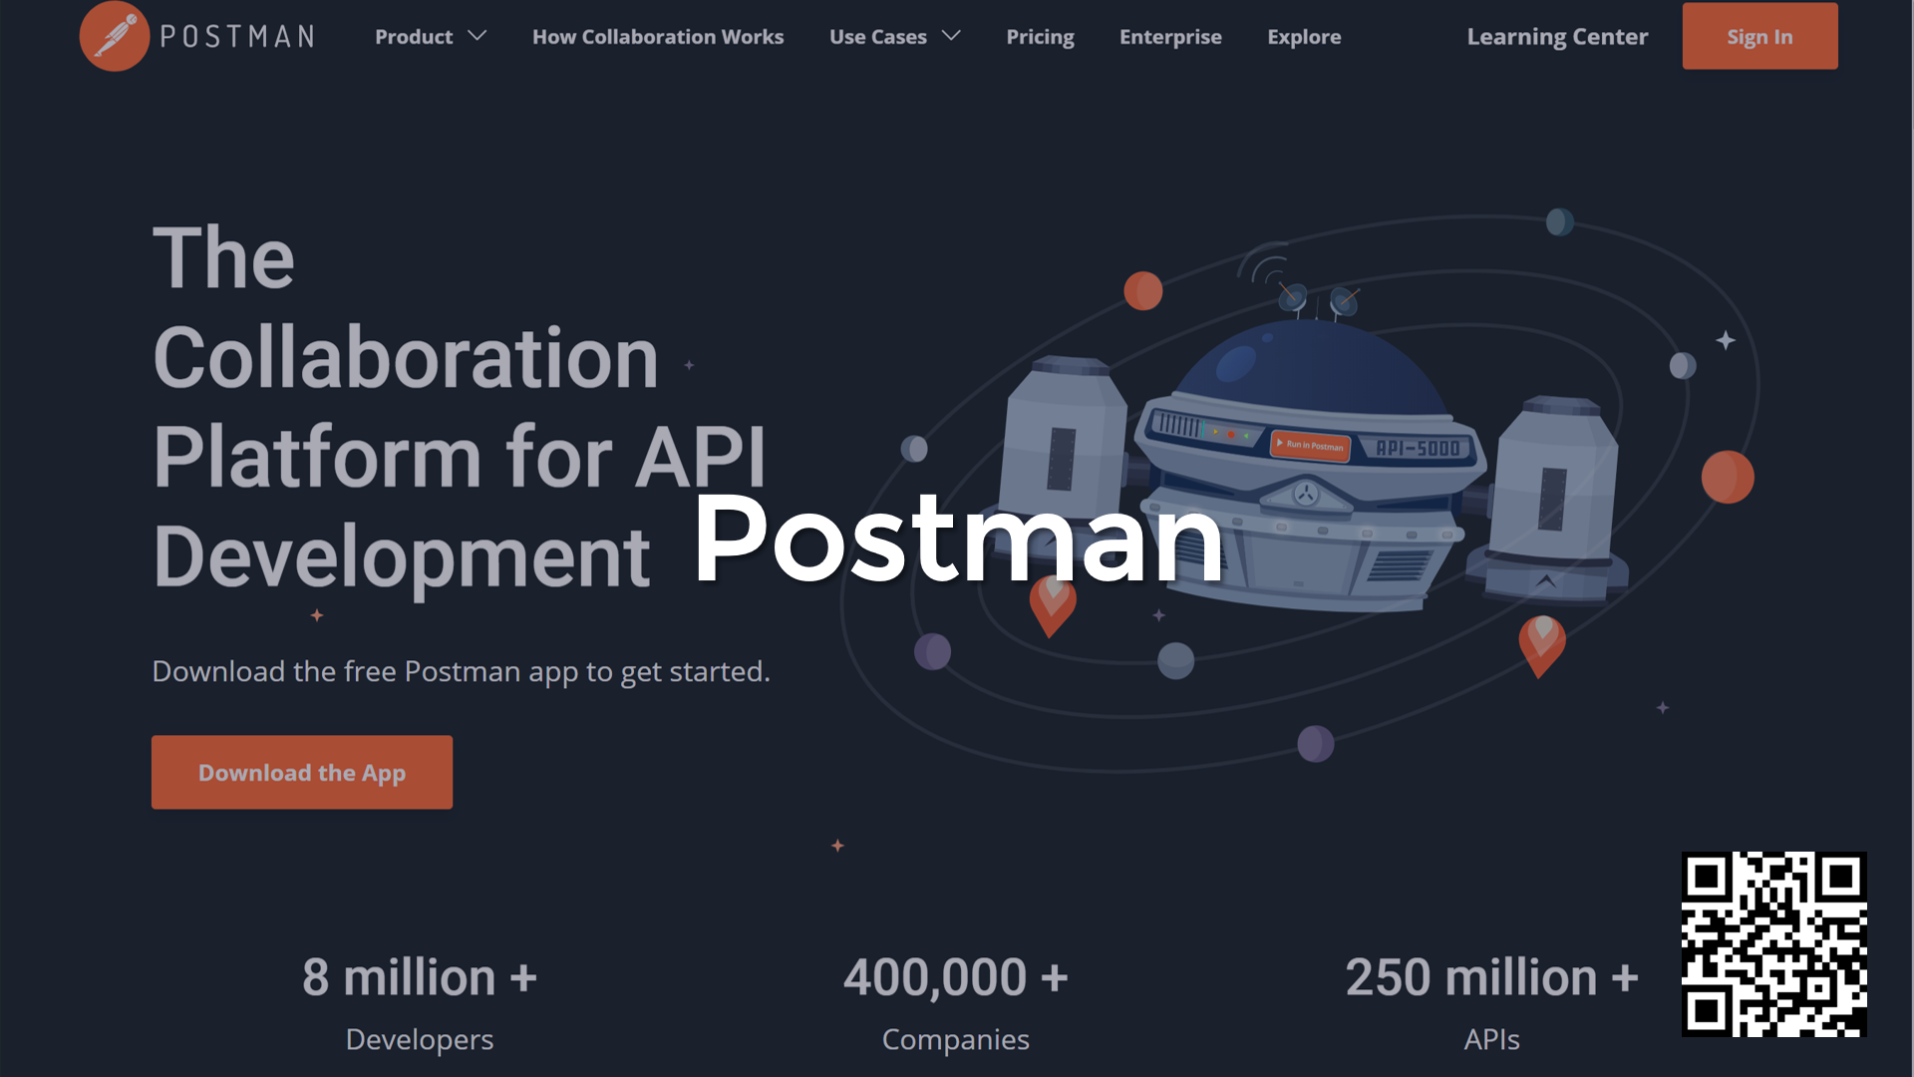

Slide 28
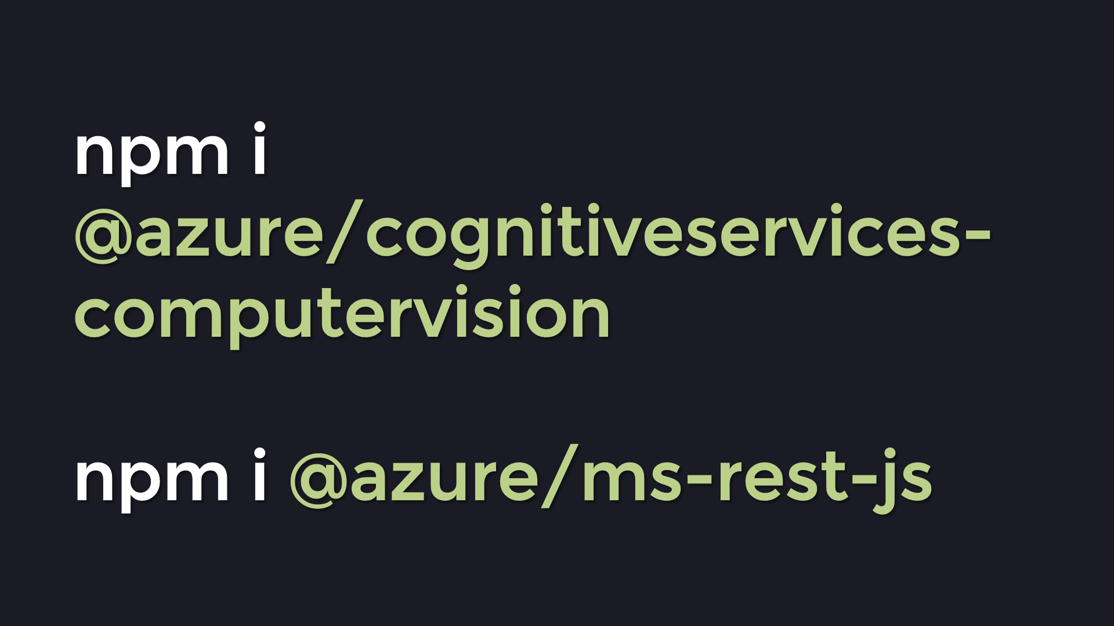

Slide 29
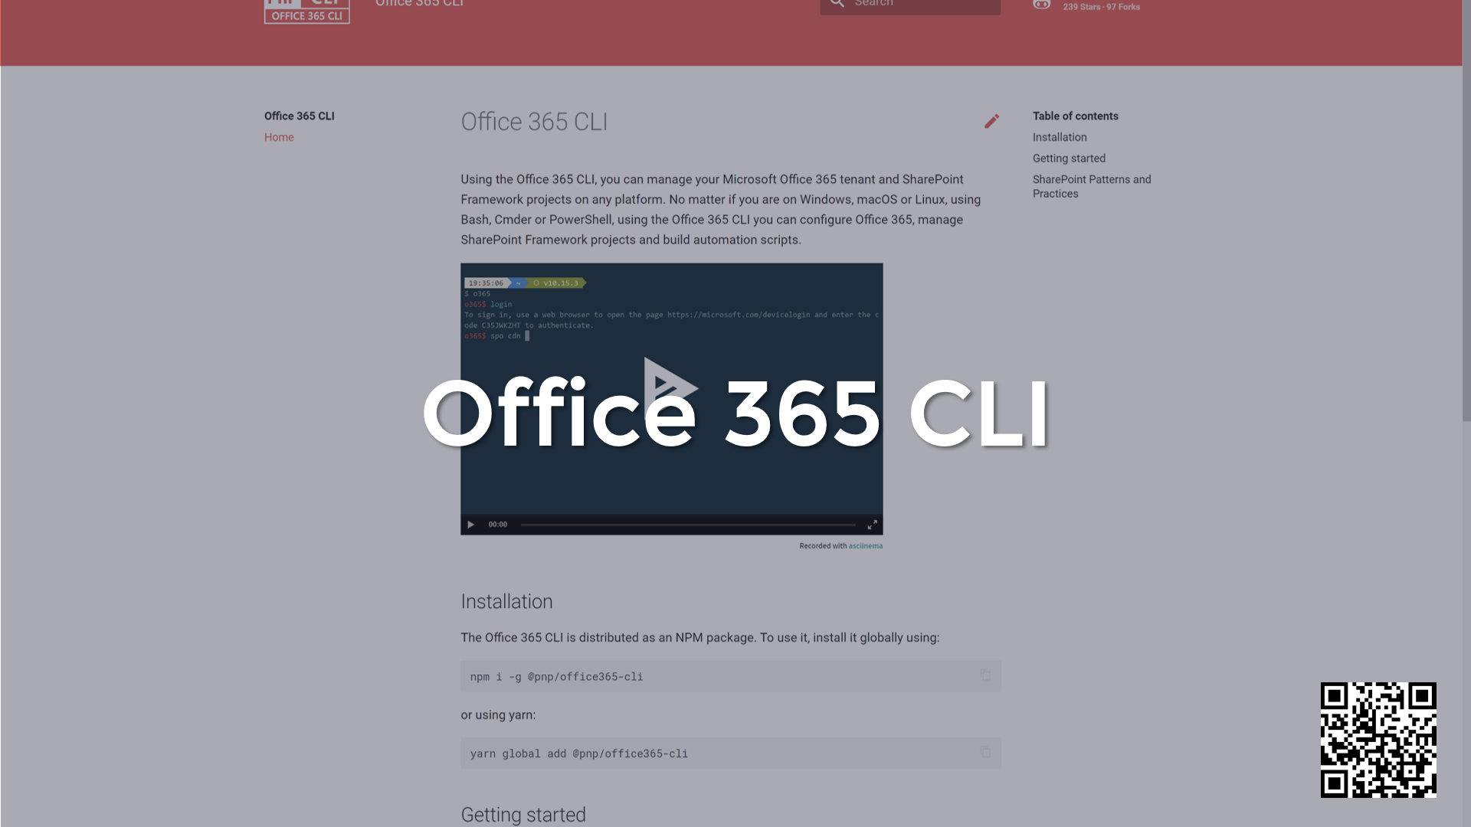

Slide 30
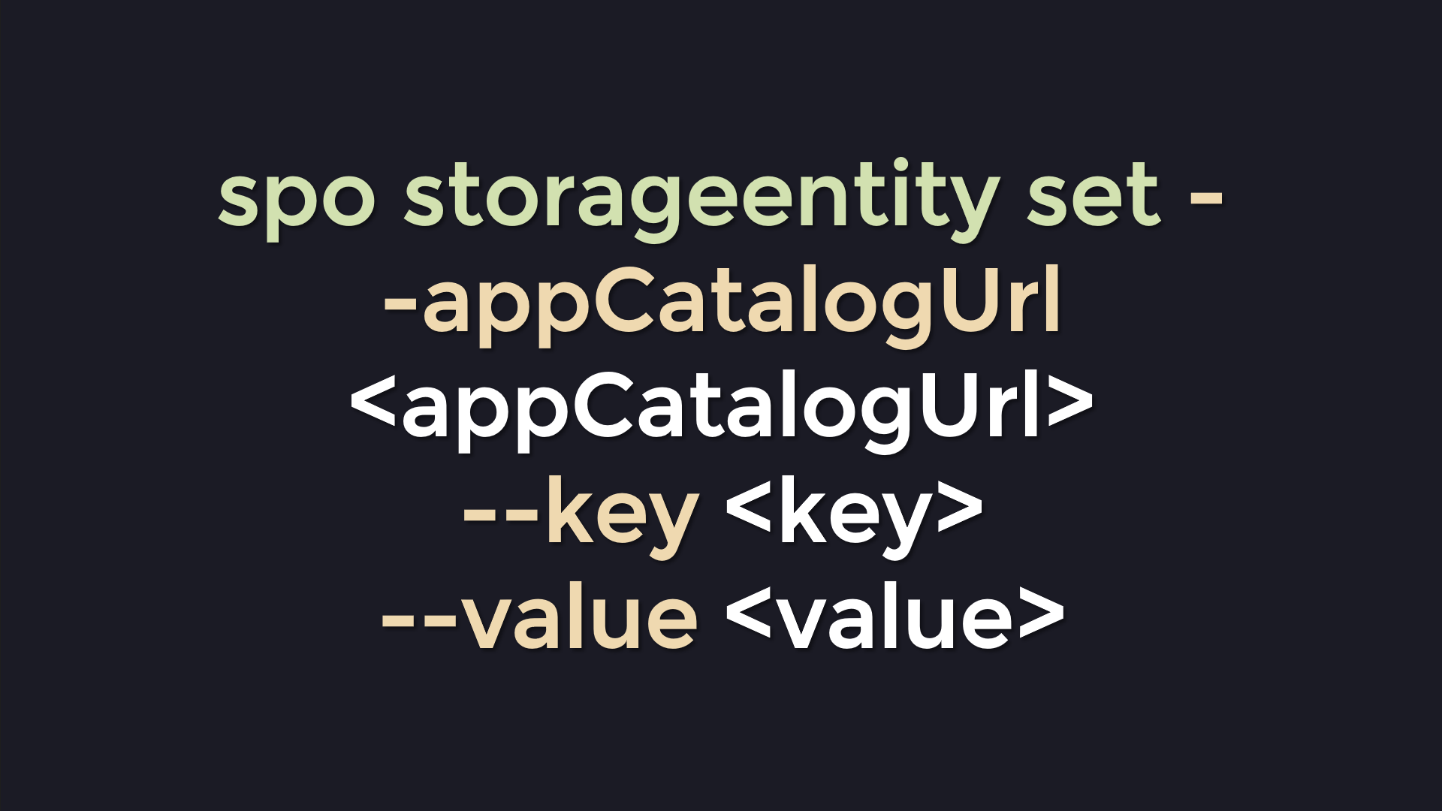

Slide 31
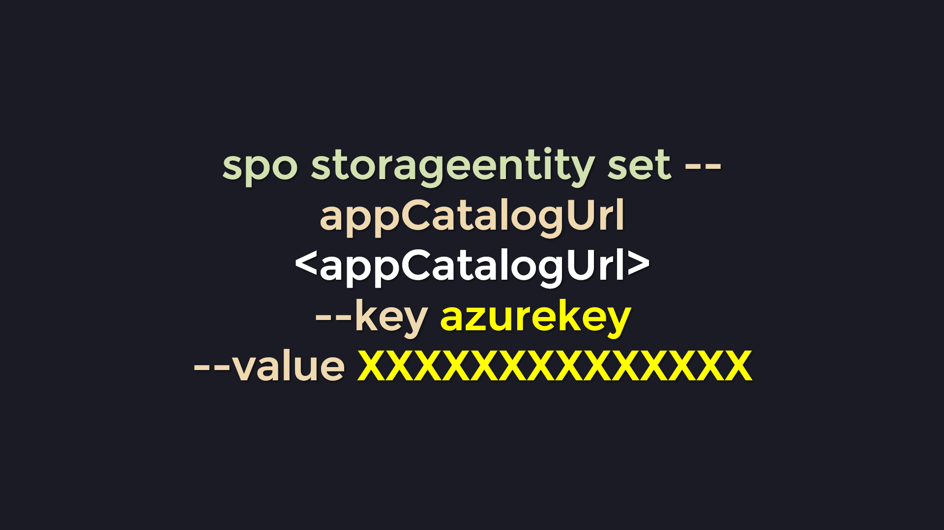

Slide 32
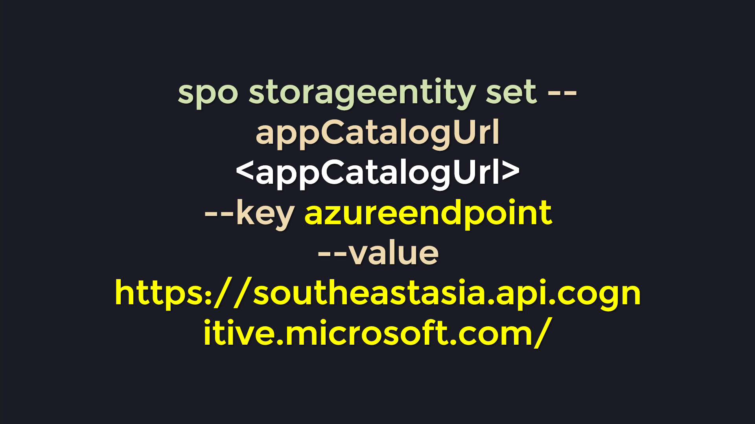

Slide 33
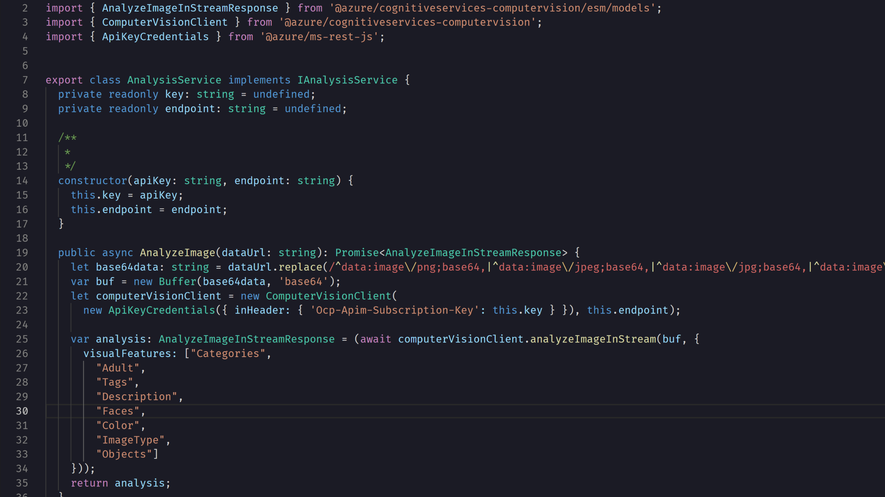

Slide 34
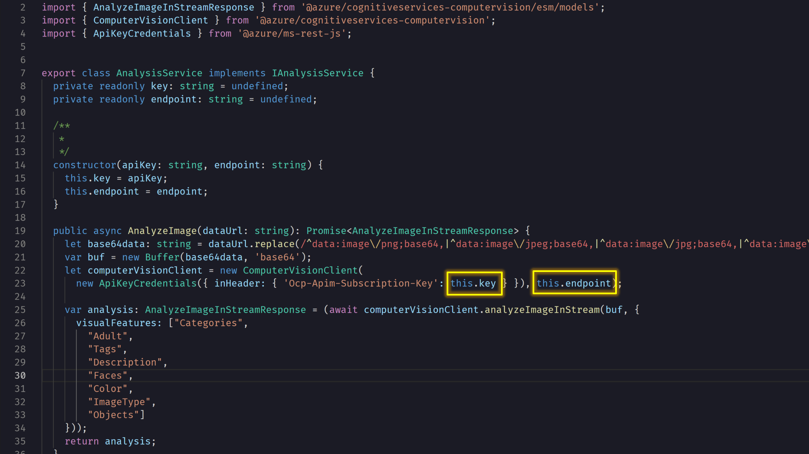

Slide 35
Demo

Slide 36
Any Questions?

